Slide 1
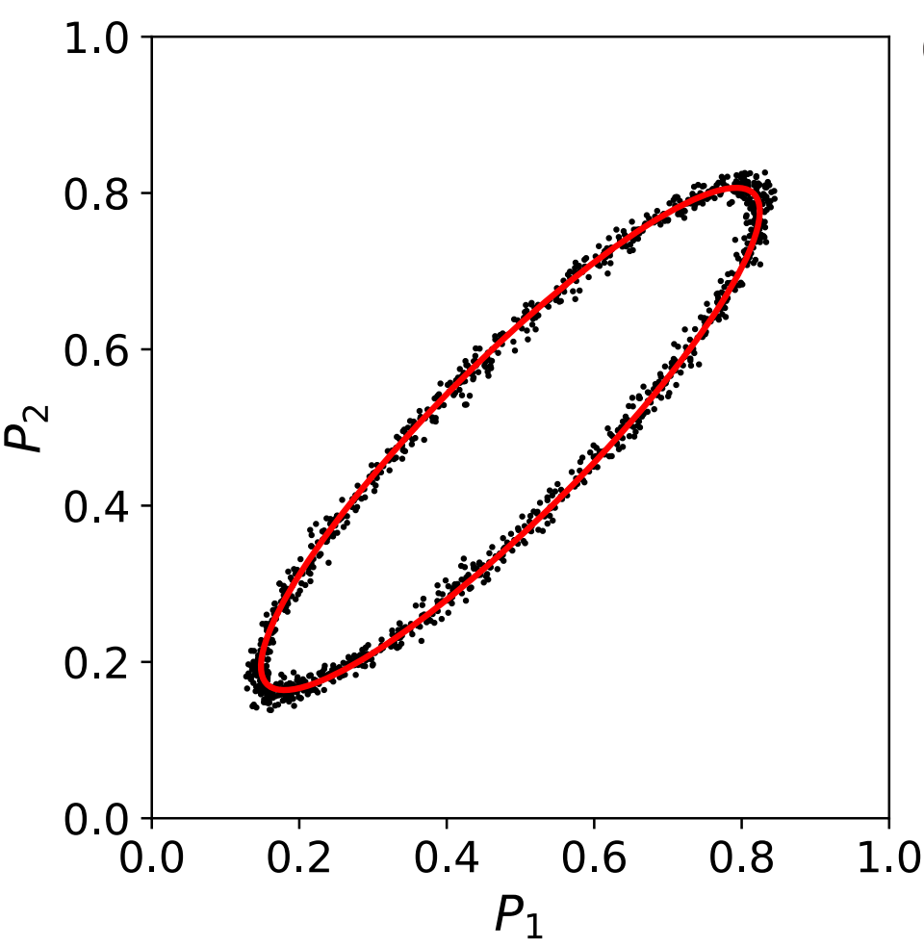
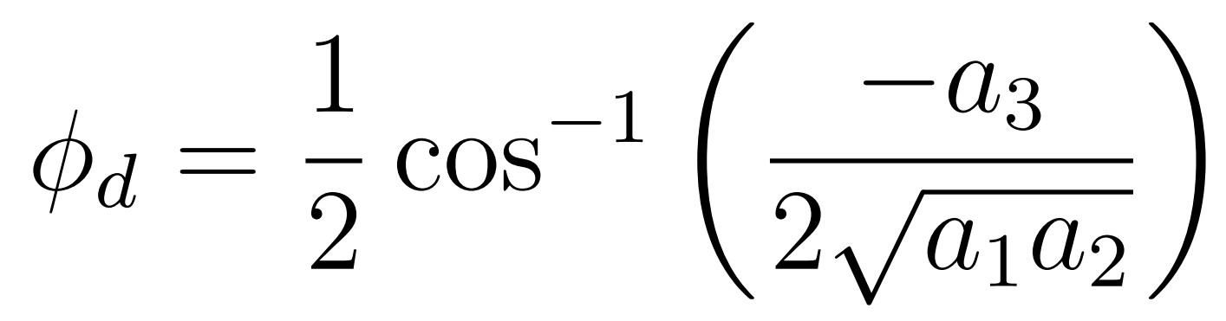
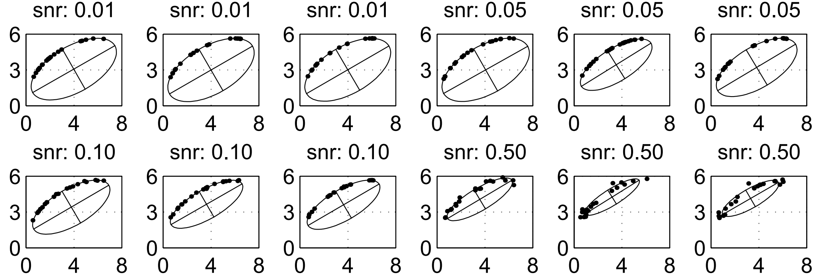
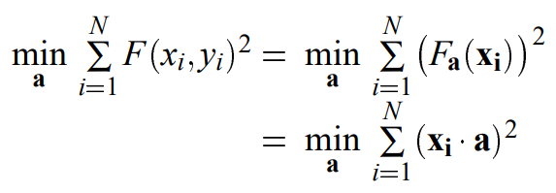
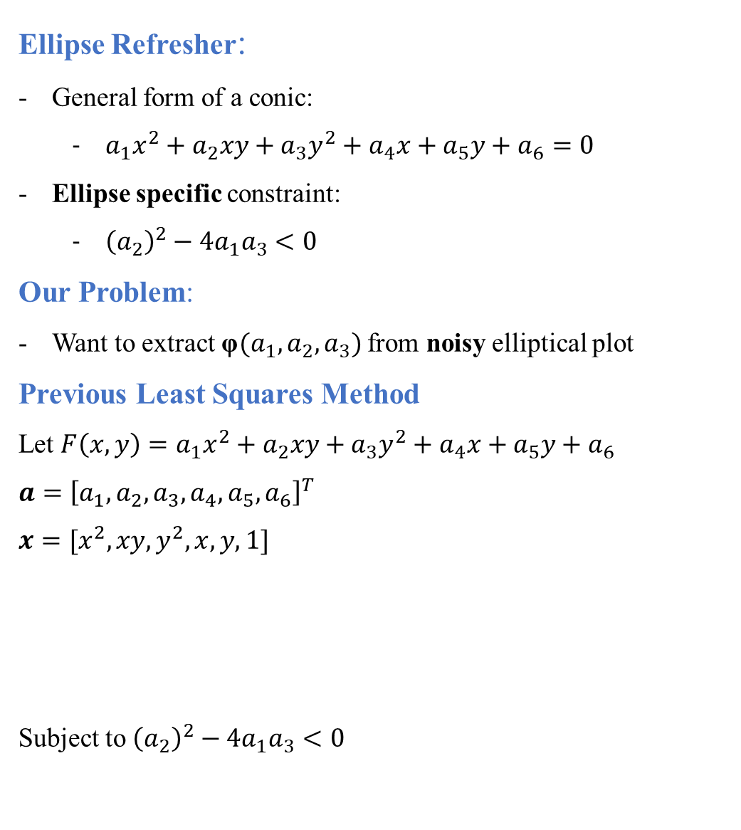
Ellipse Refresher:
General form of a conic:
$a_{1}x^{2}+a_{2}xy+a_{3}y^{2}+a_{4}x+a_{5}y+a_{6}=0$
Ellipse specific constraint:
${\left(a_{2}\right)}^{2}−4a_{1}a_{3}<0$
Our Problem:
Want to extract φ$(a_{1},a_{2},a_{3})$ from noisy elliptical plot
Previous Least Squares Method
Let $F\left(x,y\right)=a_{1}x^{2}+a_{2}xy+a_{3}y^{2}+a_{4}x+a_{5}y+a_{6}$
$$a={\left[a_{1}, a_{2},a_{3},a_{4},a_{5},a_{6}\right]}^{T}$$
$$x=[x^{2},xy, y^{2},x, y, 1]$$
Subject to ${\left(a_{2}\right)}^{2}−4a_{1}a_{3}<0$
Least-squares method applied to 12 sets of 20 points representing the same elliptical arc (center (4, 3), semiaxes (4, 2) tilt 30 degrees). Noise to signal ratio (snr) is included [Halır et al. 1998].
Notes:
Issues with least-squares:
Increase in noise results in bias towards smaller ellipses
Bias depends on ellipse parameters and cannot be simply corrected
Does not fit well near $φ=0, π$ where quantum projection noise is minimized

Slide 2
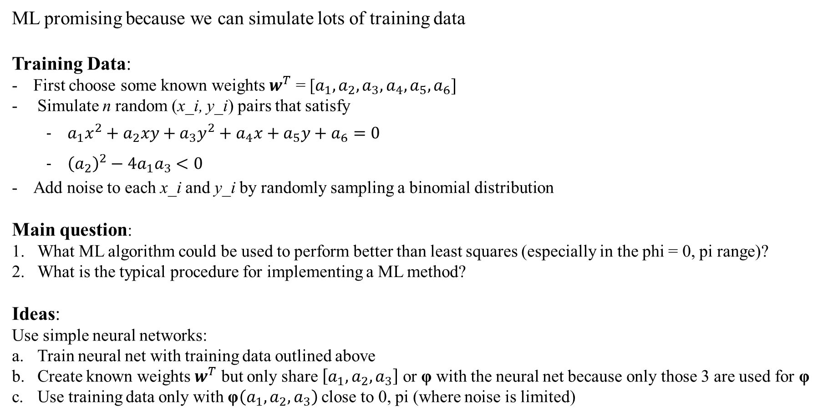
ML promising because we can simulate lots of training data
Training Data:
First choose some known weights $w^{T}$ = [$a_{1},a_{2},a_{3},a_{4},a_{5},a_{6}]$
Simulate n random (x_i, y_i) pairs that satisfy
$a_{1}x^{2}+a_{2}xy+a_{3}y^{2}+a_{4}x+a_{5}y+a_{6}=0$
${\left(a_{2}\right)}^{2}−4a_{1}a_{3}<0$
Add noise to each x_i and y_i by randomly sampling a binomial distribution
Main question:
What ML algorithm could be used to perform better than least squares (especially in the phi = 0, pi range)?
What is the typical procedure for implementing a ML method?
Ideas:
Use simple neural networks:
Train neural net with training data outlined above
Create known weights $w^{T}$ but only share $\left[a_{1},a_{2},a_{3}\right]$ or φ with the neural net because only those 3 are used for φ
Use training data only with φ$\left(a_{1},a_{2},a_{3}\right)$ close to 0, pi (where noise is limited)

